Slide 1

Group 3
Abhinav Reddy Mandadi
Koushik Kumar Reddy
Sai Teja Avadhootha
Sushanthik Reddy Poreddy
Swapan Gupta Chollati

Slide 2
Project Overview
The main objective of the project is to handle the large data that is available in the cluster.
How to perform various visualizations of the data and also check its consistency?
Since in the current world we see the huge increase in the growth of the data, we as a group thought to process the huge data and extract the features from the dataset using the MobileNet model.
The aim of feature extraction is to find the distinct patterns of the image to improve the efficiency of the classifier.

Slide 3
Project Method
Approach followed for the completion of the project:
Created separate files for train, test and validation data.
Checked for null values.
Generated plots for the dataset.
Generated feature dataset.
Predicted the labels using MobileNet Model.
Created the custom model.
Predicted labels using custom model.

Slide 4
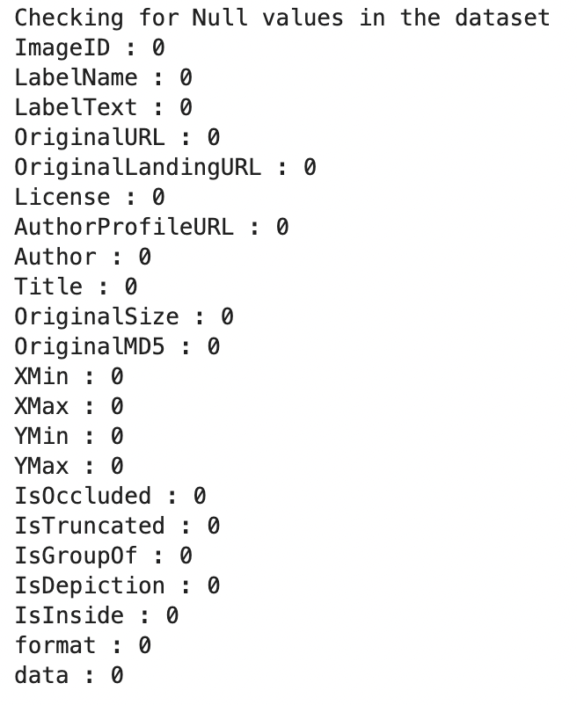
About Feature
Feature Name: Goldfish
Number of features:
Train: 2204
Test: 207
Validation: 64
Total Count: 2475

Slide 5
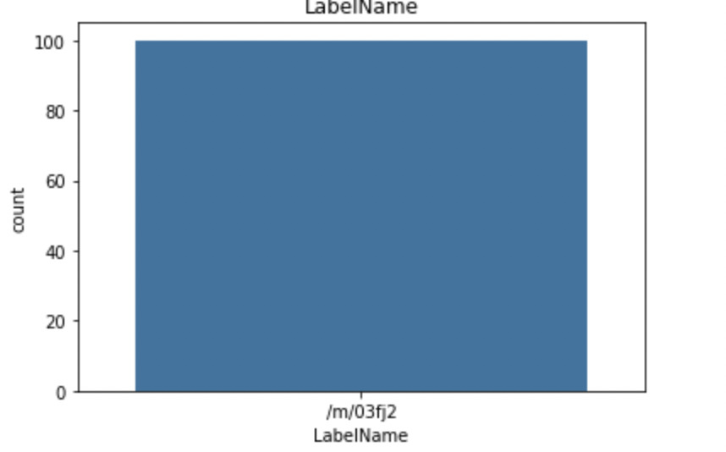
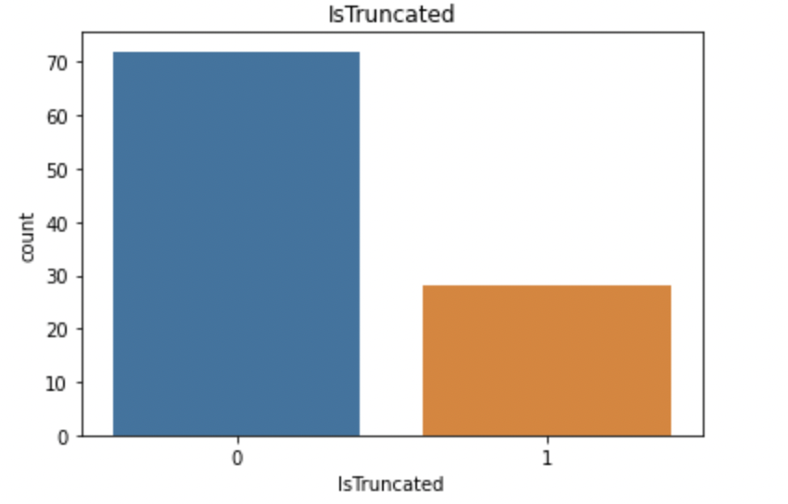
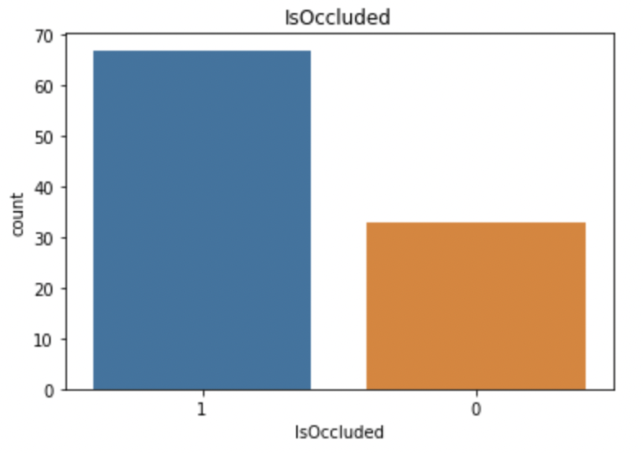
Data Visualization

Slide 6
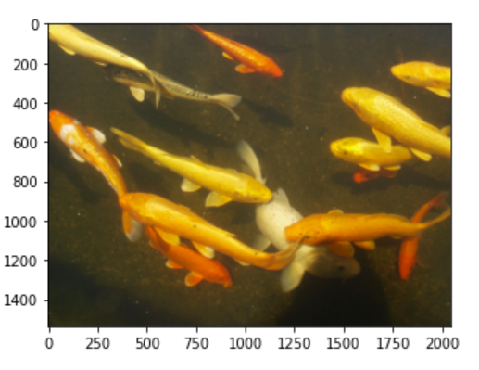
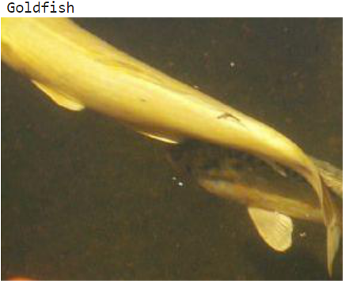
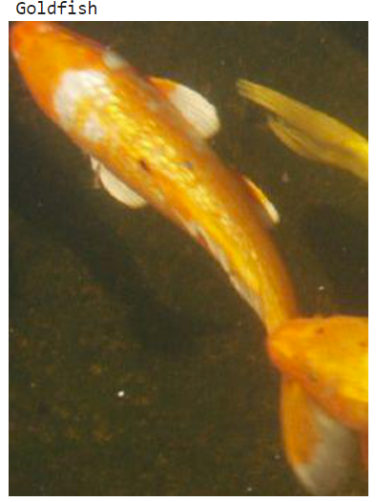
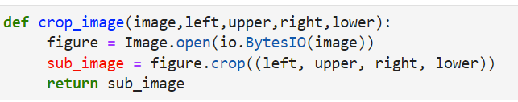
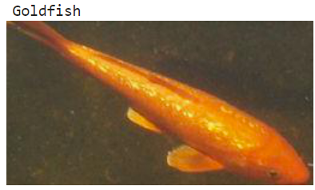
Outcome of Crop Function
Notes:
We have used bounding box information to crop the images.
We’ve run a function

Slide 7
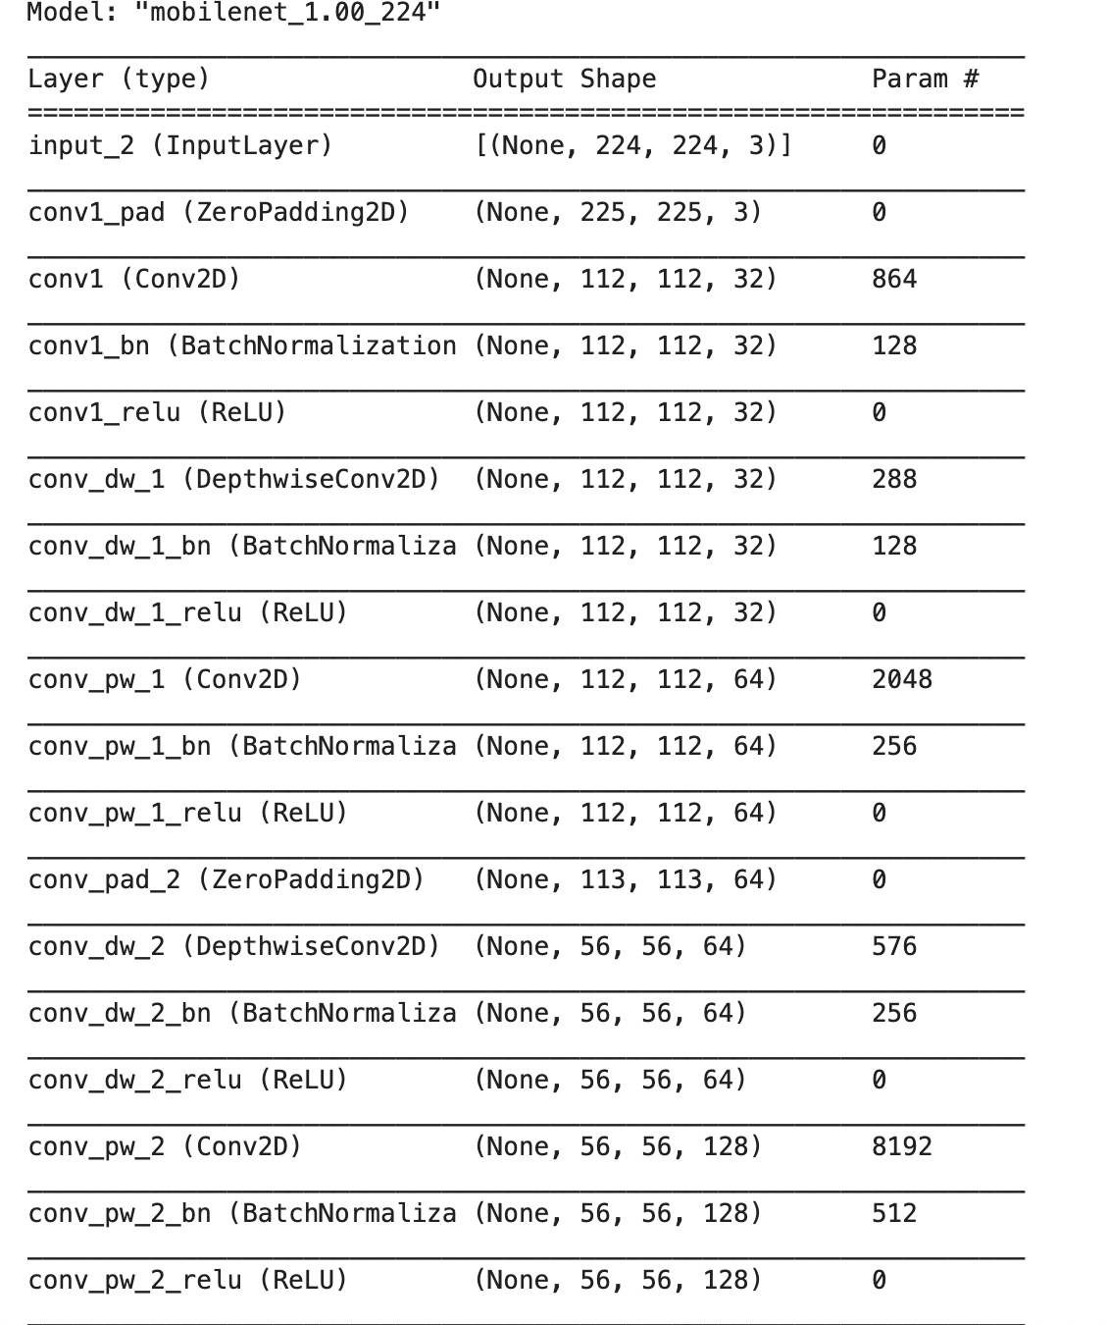
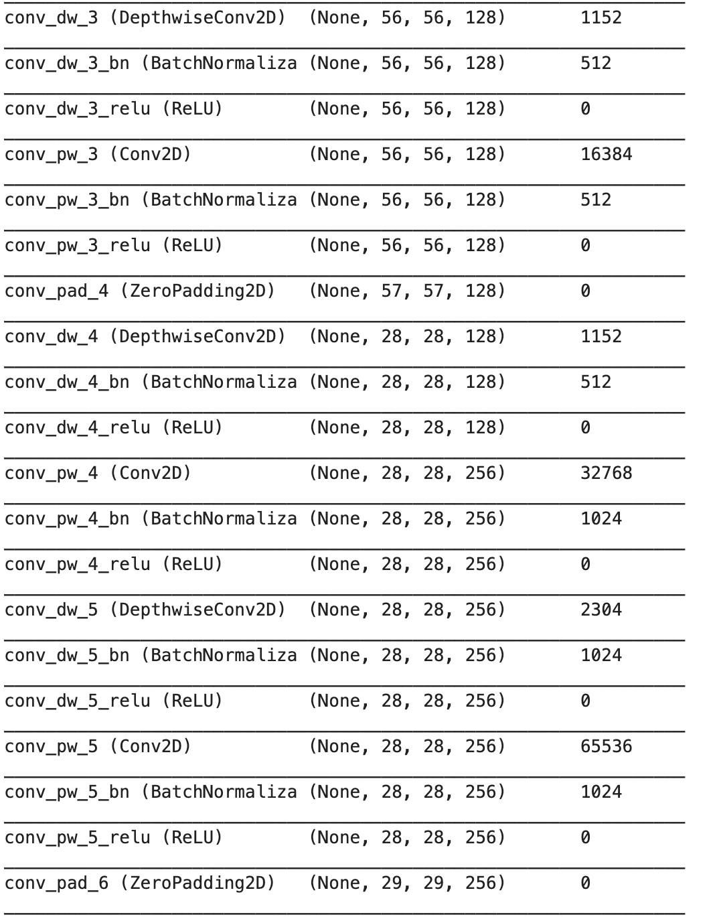
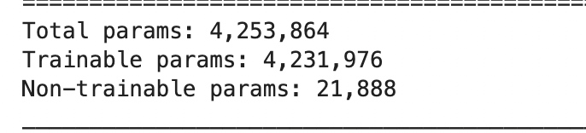
MobileNet Model
Notes:
We used a model called "MobileNet"to process the image data that is capable to run the testing set, validation set and the test set.
We can observe that there are about 4.2 million parameters which are pre trained.
We introduce two simple global hyperparameters that efficiently trade off latency and accuracy.

Slide 8
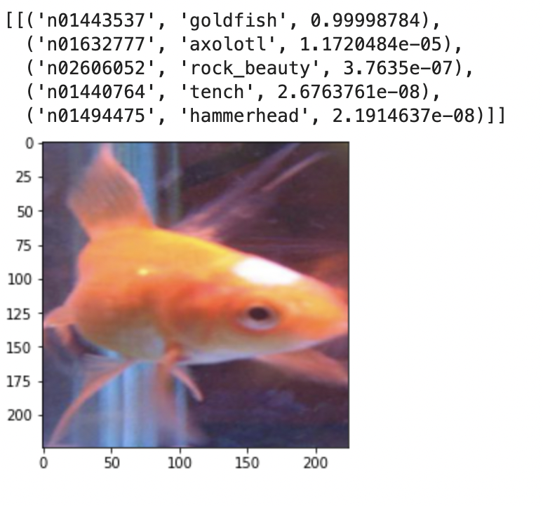
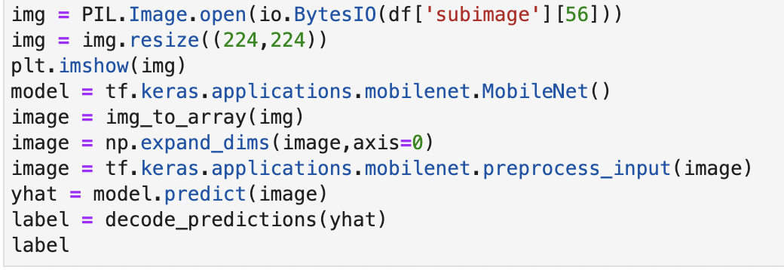
Model Outcome

Slide 9
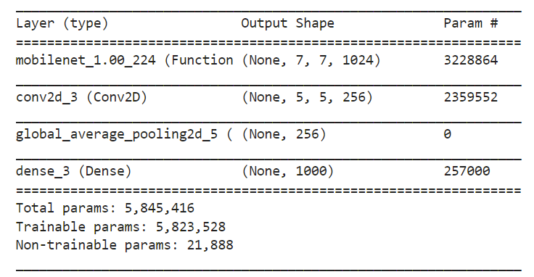
Custom Model

Slide 10
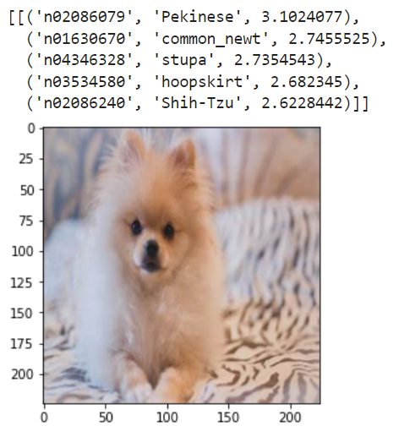
Custom Model Outcome

Slide 11
Challenges Faced & Current Status
Problem in creating test data for custom work due to permission issue to read the image.
Due to dimension issues we were not able to fit the data to the model.
Adding custom layers to the existing model.
Working on Pyspark Dataframe.
Choosing the correct layers.

Slide 12
Conclusion
Using MobileNet Model we were able to predict the features based on the pretrained label names.
Accuracy for base model: 0.99 (99%)
Accuracy for custom model:
Though we built the custom model by adding the layers but it didn’t give the accurate result.

Slide 13

Future Scope
We trained the model with adding few layers to the existing model but the predicted results were not accurate, checking the layers may improve the accuracy.

